Slide 1

DATA VISUALIZATION PROJECT AD-HOC INSIGHTS for CONSUMER GOOD DOMAIN
Submitted by Aryadevi R

Slide 2
BUSINESS OBJECTIVE
Atliq Hardware: Leading Computer Hardware Production in India and Beyond
Challenge: Management needs better insights for quick, data-informed decisions.
Opportunity: Expanding the analytics team by hiring a junior data analyst with strong technical and soft skills.
Project: Conducting an SQL challenge to assess candidates’ skills.

Slide 3
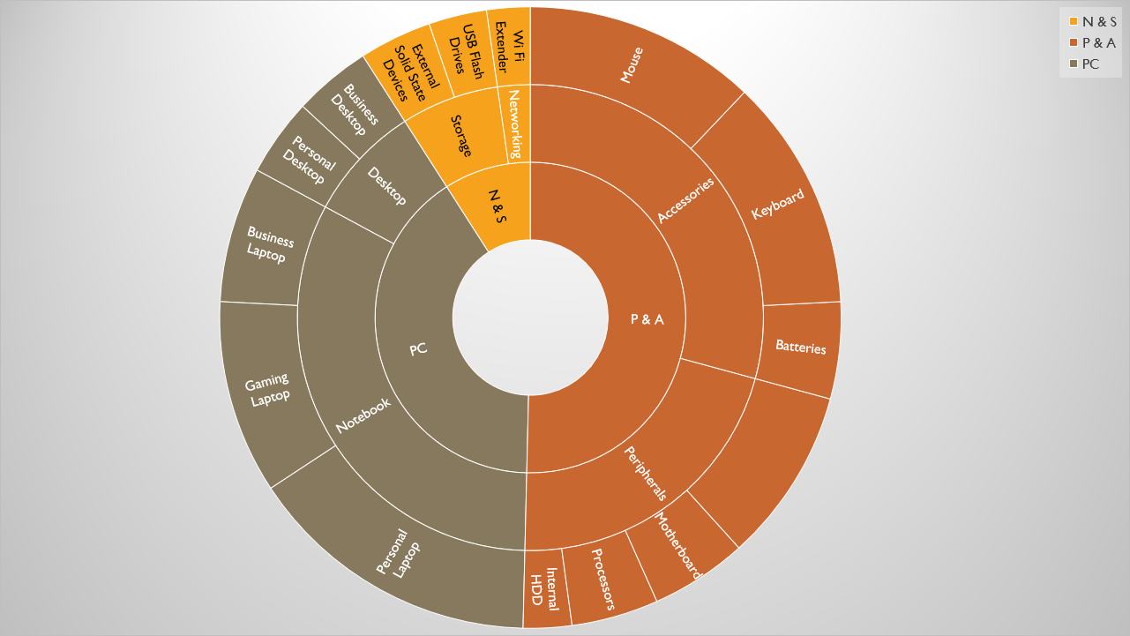
ATLIQ PRODUCTS

Slide 4
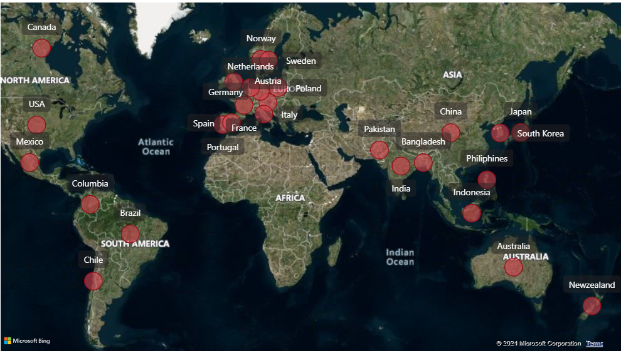
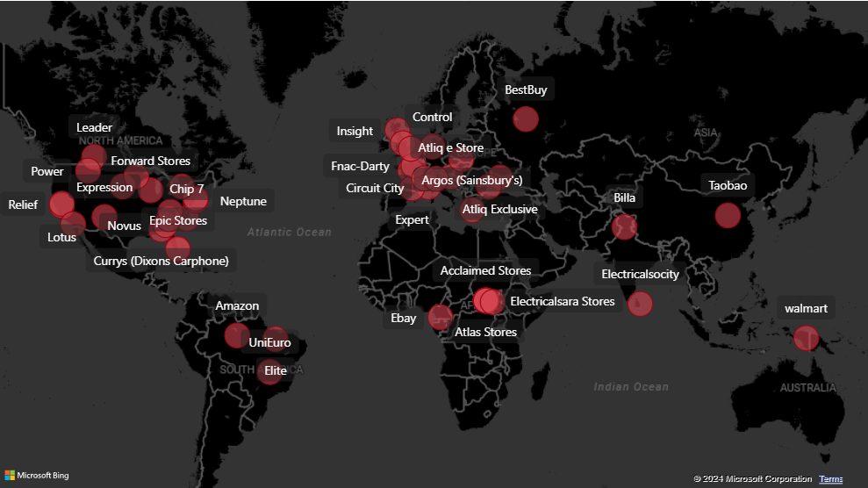
MARKETS
CUSTOMERS

Slide 5
PROBLEM STATEMENT/PROJECT SCOPE
Identify the data source and loaded to the database
Clean and model the data as per requirement for analysis
Executing ad-hoc request and creating dashboards

Slide 6
SOLUTION APPROACH
There are 6 tables provided, 2 dimension tables (customer, product) and 4 fact tables (gross_price, manufacturing cost, sales_monthly, preinvoice_deductions)
MySQL workbench was used to load the dump file and run the ad-hoc requests
Power BI was the tool used for creating the visualizations
Data was imported, analyzed and transformed from MySQL database within Power Query
The relationships between the tables were created within Power Pivot

Slide 7
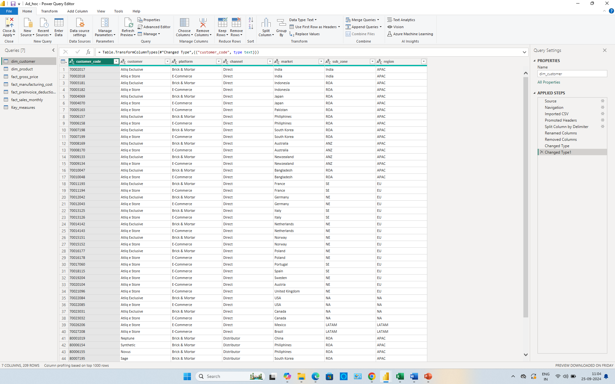
DATA CLEANING/TRANSFORMATION IN POWER QUERY

Slide 8
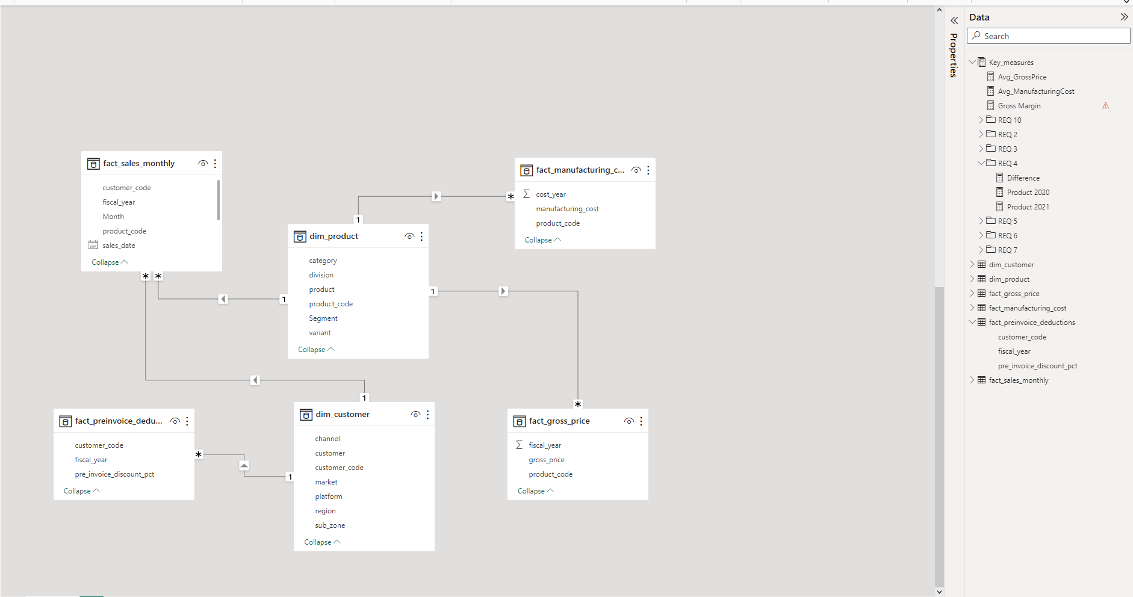
DATA modelling IN POWER pivot

Slide 9
SOLUTION APPROACH
A few measures were created to calculate the KPIs as shown below:
Unique product count - Unique products sold counted from fact_sales_monthy
Percentage change - Unique Product 2021-Unique Product 2020 / Unique Product 2020
Difference - Unique Product 2021-Unique Product 2020
Min and Max manufacturing cost - Minimum and maximum manufacturing cost is calculated from fact_manufacturing_cost

Slide 10
SOLUTION APPROACH
A few measures were created to calculate the KPIs as shown below:
Avg_pre_invoice_ct - This is calculated from fact_preinvoice_deductions
Gross_sales_amount - sold_quantity * gross_price is calculated by inner joining tables fact_sales_monthly, fact_gross_price and multiplying
Total_sold_quantity - This is calculated by summing sold_quantity from fact_sales_monthly

Slide 11
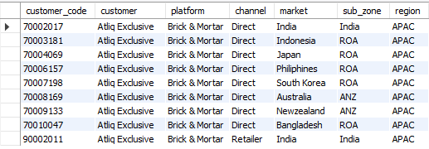
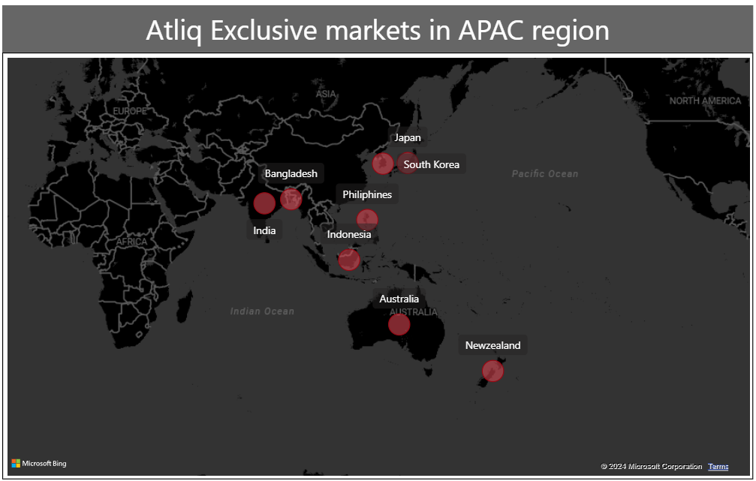
INSIGHTS
OUTPUT
1. Provide the list of markets in which customer “Atliq Exclusive” operates its business in the “APAC” REGION
India
Indonesia
Japan
Philippines
South Korea
Australia
New Zealand
Bangladesh

Slide 12
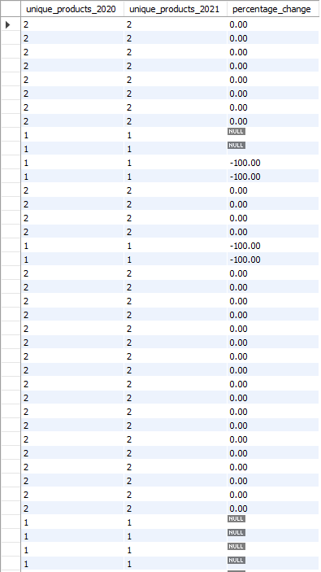
INSIGHTS
OUTPUT
2.What is the percentage of unique product increase in 2021 vs. 2020? The final output contains these fields,
unique_products_2020
unique_products_2021
percentage_chg

Slide 13
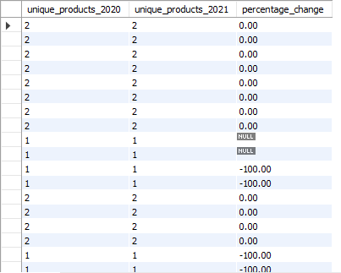
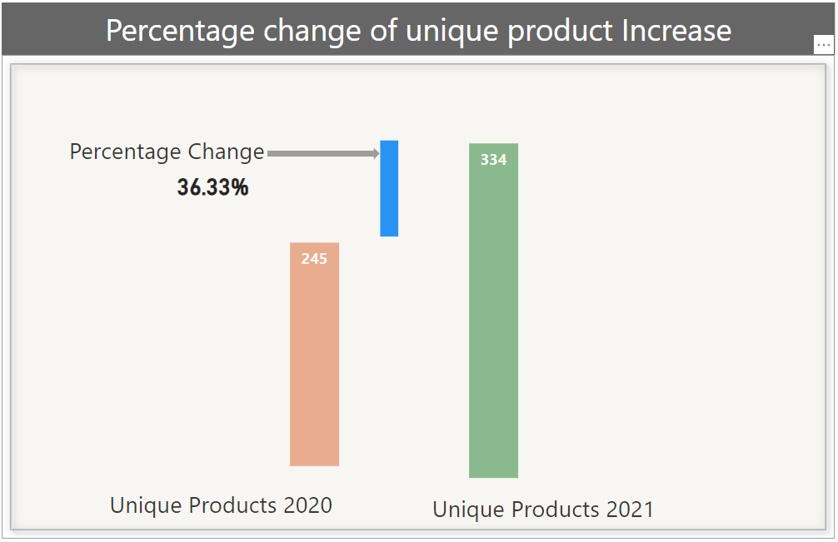
INSIGHTS
OUTPUT TO VISUAL
FY 2020: 245 unique products
FY 2021: 334 unique products
Percentage Change: 36.33% increase, indicating significant growth in 2021

Slide 14
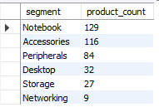
INSIGHTS
OUTPUT
3. Provide a report with all the unique product counts for each segment and sort them in descending order of product counts. The final output contains 2 fields,
segment
product_count

Slide 15
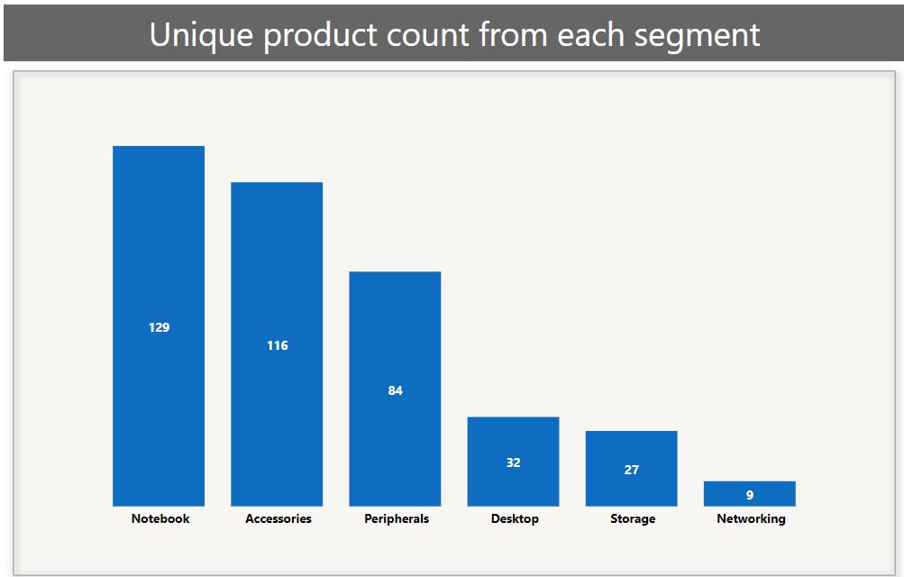
INSIGHTS
OUTPUT TO VISUAL
Highest Production Volume: Notebooks lead with the highest number of products manufactured.
Lowest Production Volume: Networking products have the least number of products.

Slide 16
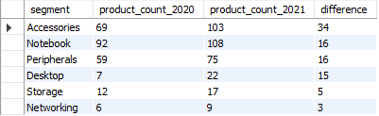
INSIGHTS
OUTPUT
4. Which segment had the most increase in unique products in 2021 vs 2020? The final output contains these fields,
segment
product_count_2020
product_count_2021
difference

Slide 17
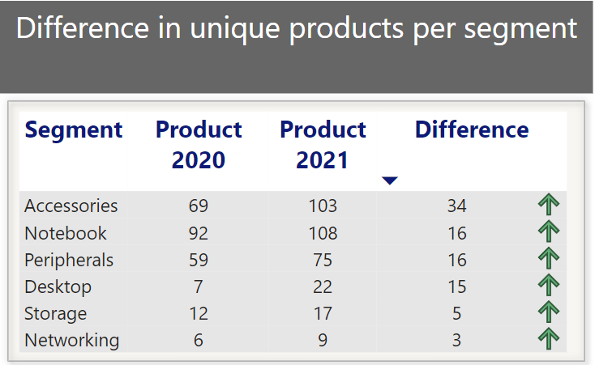
INSIGHTS
OUTPUT TO VISUAL
Significant Growth: Accessories saw the highest increase from the previous year.
Minimal Change: Storage and Networking products experienced very low fluctuations.

Slide 18
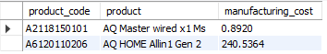
INSIGHTS
OUTPUT
5. Get the products that have the highest and lowest manufacturing costs. The final output should contain these fields,
product_code
product
manufacturing cost

Slide 19
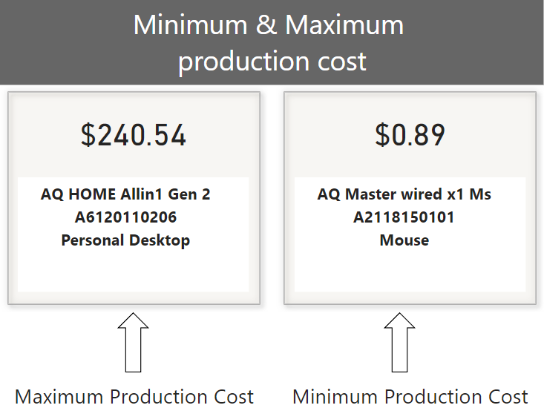
INSIGHTS
OUTPUT TO VISUAL
Maximum Production Cost:
Item: Personal Desktop
Code: A6120110206
Cost: $240.54
Minimum Production Cost:
Item: Mouse
Code: A2118150101
Cost: $0.89

Slide 20
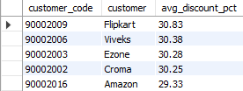
INSIGHTS
OUTPUT
6. Generate a report which contains the top 5 customers who received an average high pre_invoice_discount_pct for the fiscal year 2021 and in the Indian market. The final output contains these fields,
customer_code
customer
average_discount_percentage

Slide 21
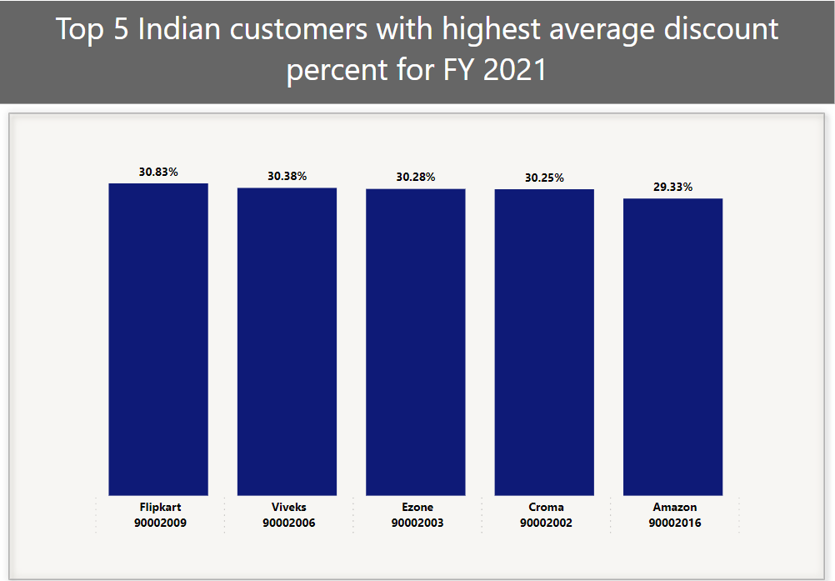
INSIGHTS
OUTPUT TO VISUAL
Top 5 Indian customers with highest average discount in FY 2021:
Flipkart – 30.83%
Viveks – 30.38%
Ezone – 30.28%
Croma – 30.25%
Amazon –29.33%

Slide 22
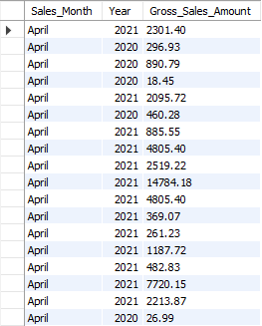
INSIGHTS
OUTPUT
7. Get the complete report of the Gross sales amount for the customer “Atliq Exclusive” for each month . This analysis helps to get an idea of low and high-performing months and take strategic decisions. The final report contains these columns:
Month
Year
Gross sales Amount

Slide 23
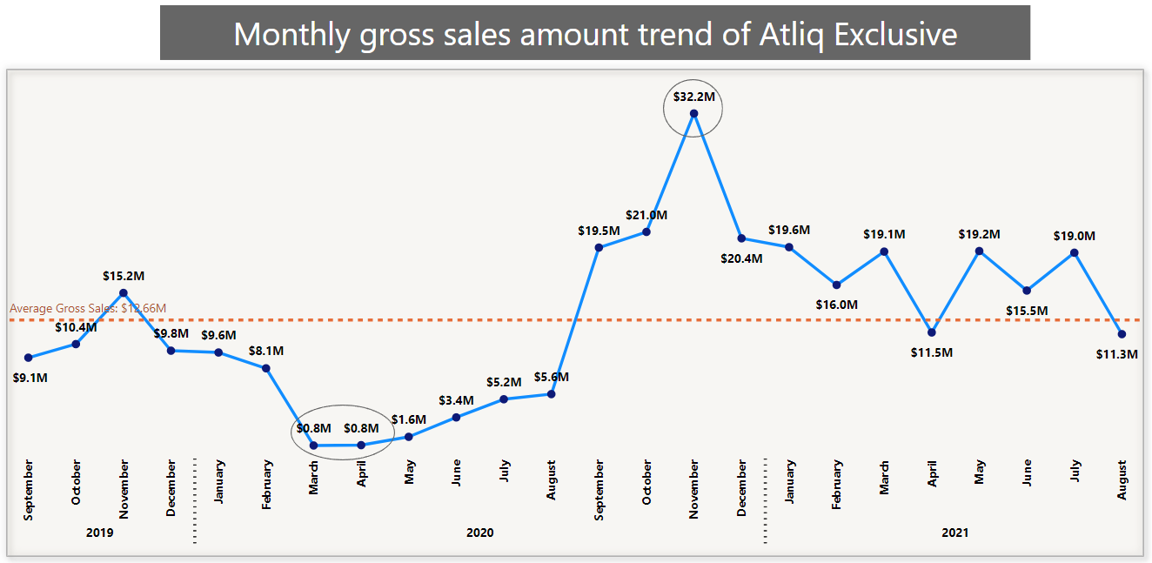
INSIGHTS
OUTPUT TO VISUAL
Atliq Exclusive Gross Sales Report
2019:
November: Highest gross sales, above average.
Other Months: Below average, with a decline post-November until September 2020.
2020:
March & April: Lowest gross sales across three years.
November: Peak gross sales, highest among all three years.
Post-November: Sales remained above average, except for April and August 2021.
2021:
January: Highest gross sales.
August: Lowest gross sales.

Slide 24
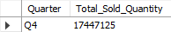
INSIGHTS
OUTPUT
8. In which quarter of 2020, got the maximum total_sold_quantity? The final output contains these fields sorted by the total_sold_quantity,
Quarter
total_sold_quantity

Slide 25
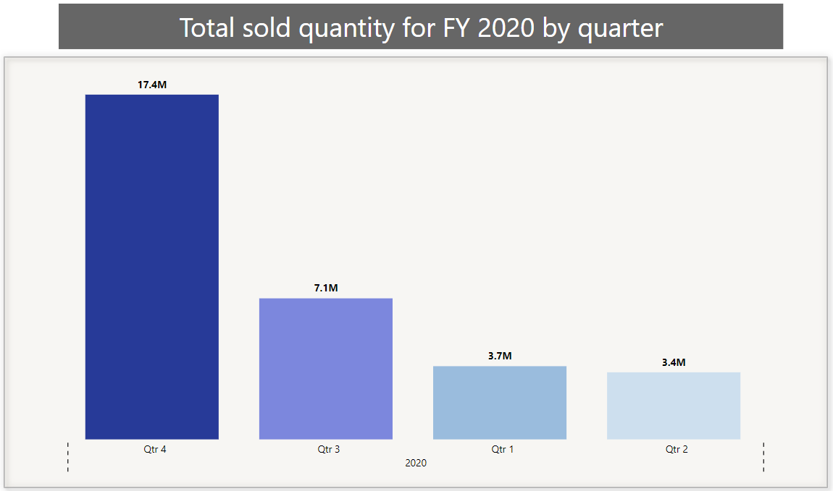
INSIGHTS
OUTPUT TO VISUAL
Highest Sales : Q4
Lowest Sales : Q2
Trend: Significant increase in sales after Q2

Slide 26
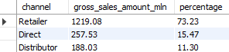
INSIGHTS
OUTPUT
9. Which channel helped to bring more gross sales in the fiscal year 2021 and the percentage of contribution? The final output contains these fields,
channel
gross_sales_mln
percentage

Slide 27
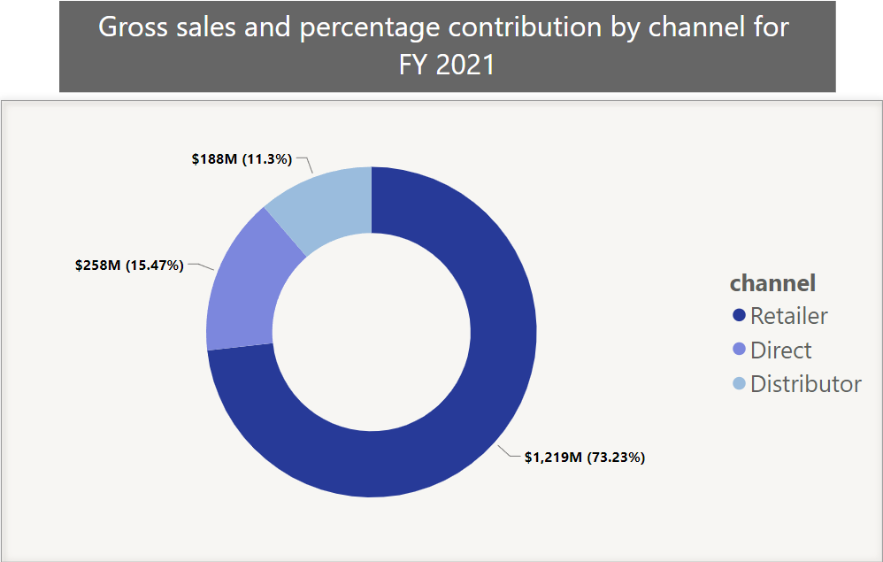
INSIGHTS
OUTPUT TO VISUAL
Highest gross sales and percentage contribution : Retailer
Lowest gross sales and percentage contribution : Distributor

Slide 28
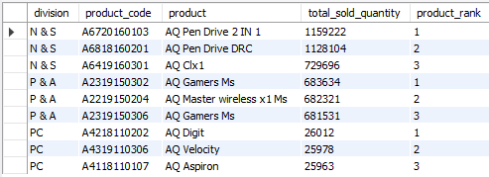
INSIGHTS
OUTPUT
10. Get the Top 3 products in each division that have a high total_sold_quantity in the fiscal_year 2021? The final output contains these fields,
division
product_code
product
total_sold_quantity
rank_order

Slide 29
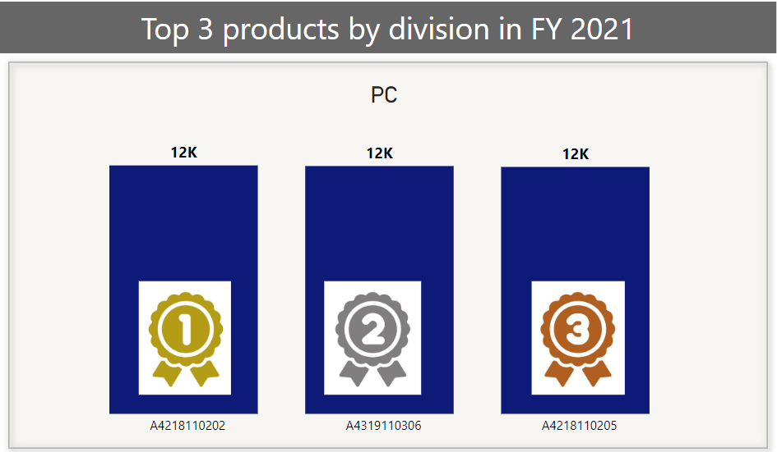
INSIGHTS
OUTPUT TO VISUAL
Top 3 products in PC division:
A4218110202
A4319110306
A4218110205

Slide 30
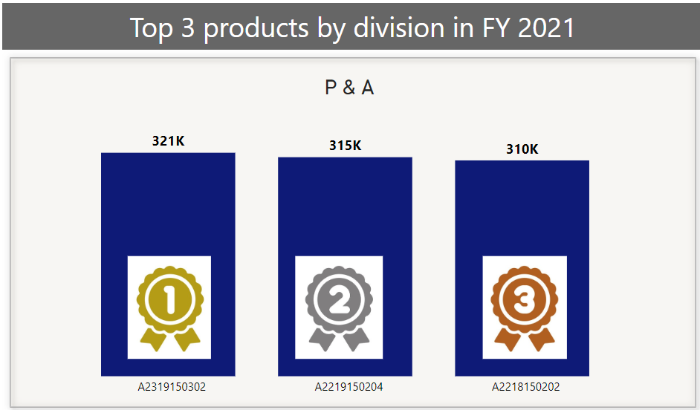
INSIGHTS
OUTPUT TO VISUAL
Top 3 products in P & A division:
A2319150302
A2219150204
A2319150306

Slide 31
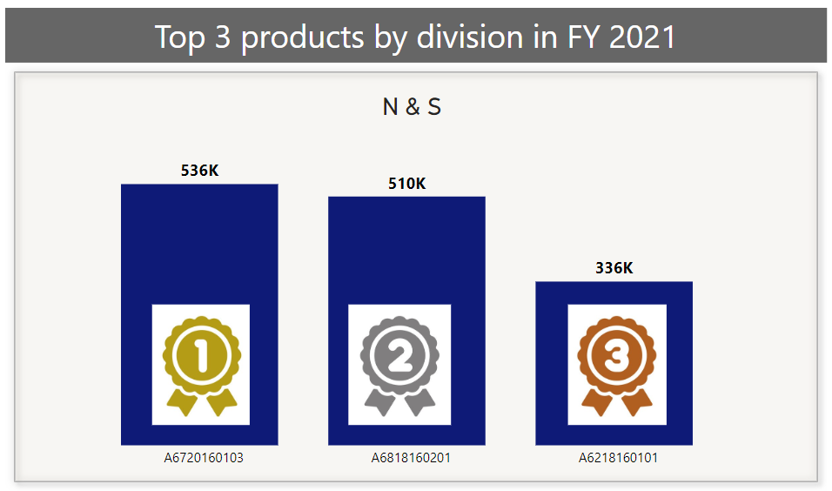
INSIGHTS
OUTPUT TO VISUAL
Top 3 products in N & C division:
A6720160103
A6818160201
A6419160301

Slide 32
CONCLUSION
Ad-Hoc Requests: Successfully developed business insights to support strategic decision-making.
In-Depth Study: Provided comprehensive analysis of the consumer goods domain and its metrics.
Stakeholder Benefits: Enabled stakeholders to draw valuable conclusions on gross sales across various products and global markets, facilitating the development of new strategies to boost sales.

Slide 33


